Slide 1
UNIT 5 and 6 Combinational Logic
Prepared By
Er.Harendra Bikram Shah
(Lecturer)
Department of Computer Engineering

Slide 2
OUTLINES
Introduction
Adders and Subtractors
CODE conversion( BCD to excess-3, 8 4 -2 -1 code to bcd, 2421 code to 8 4 -2 1 code)
Decoder and Encoder
Multiplexer and De-multiplexer
BCD to 7 segment decoder
ROM and PLA

Slide 3
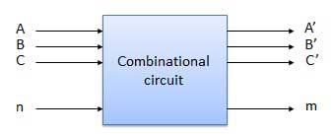
Introduction
Combinational circuit/combinational logic is a type of logic circuit which is the combination of different gates in the
circuit where the output is a pure function of the present input only.
characteristics of combinational circuits are following :-
The output of combinational circuit at any instant of time, depends only on the levels present at input terminals.
The combinational circuit do not use any memory. i.e. previous state of input does not have any effect on the present state
of the circuit.
A combinational circuit can have an n number of inputs and m number of outputs.
Block diagram

Slide 4
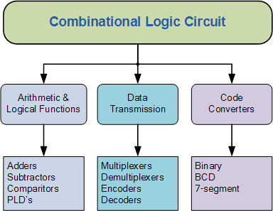
Classification of Combinational Logic

Slide 5
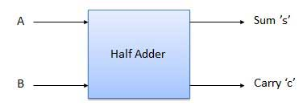
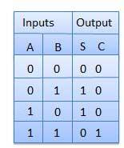
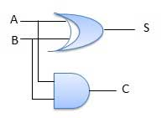
Adders
An adder is a device that will add together two bits and give the result as the output.
There are two kinds of adders - half adders and full adders
Half Adder
Half adder is a combinational logic circuit with two inputs and two outputs.
The half adder is able to add two single binary digits and provide the output plus a carry value
This circuit has two outputs carry and sum.
A half adder is a type of adder, an electronic circuit that performs the addition of numbers.
The common representation uses a XOR logic gate and an AND logic gate.
Block diagram Truth Table
Logic Expression
Sum= A XOR B
Carry = A AND B
Circuit Diagram/combinational circuit diagram

Slide 6
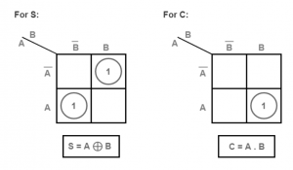
Logic Expression
Sum= A XOR B
Carry = A AND B
The half adder K-map is

Slide 7
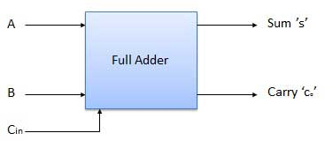
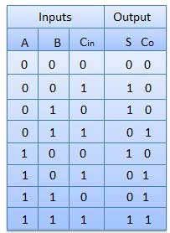
Full Adders
Full adder is developed to overcome the drawback of Half Adder circuit.
Full adders is a combinational circuit that has 3 inputs and two outputs i.e. A,B ,Cin and Sum and Carry out
It can add two one-bit numbers A and B, and carry c.
Block diagram Truth Table

Slide 8
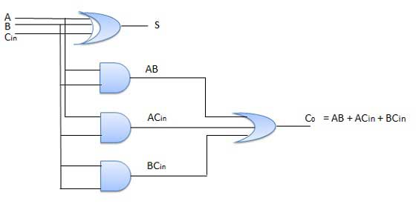
Circuit Diagram/combinational circuit diagram
Logic Expression
SUM = (A XOR B) XOR Cin = (A ⊕ B) ⊕ Cin
CARRY-OUT = A AND B OR Cin(A XOR B) = A.B + Cin(A ⊕ B)

Slide 9
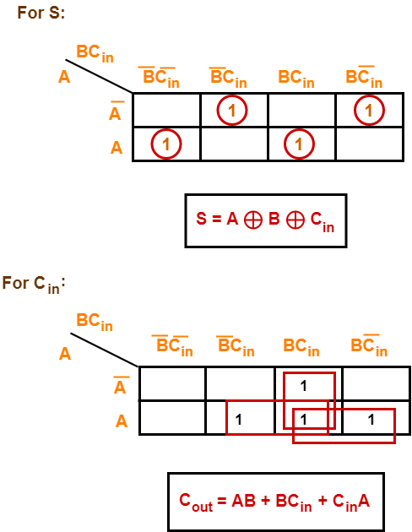
Logic Expression
SUM = (A XOR B) XOR Cin = (A ⊕ B) ⊕ Cin
CARRY-OUT = A AND B OR Cin(A XOR B)
= A.B + Cin(A ⊕ B)
The full adder K-Map is

Slide 10
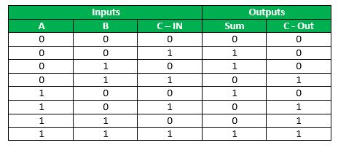
Implementation of Full adder using two half adder and one OR gate
Full Adder Truth Table:
Logical Expression for SUM: = A’ B’ C-IN + A’ B C-IN’ + A B’ C-IN’ + A B C-IN = C-IN (A’ B’ + A B) + C-IN’ (A’ B + A B’) = C-IN XOR (A XOR B) = (1,2,4,7)

Slide 11
Logical Expression for C-OUT: = A’ B C-IN + A B’ C-IN + A B C-IN’ + A B C-IN = A B + B C-IN + A C-IN = (3,5,6,7)
Another form in which C-OUT can be implemented: = A B + A C-IN + B C-IN (A + A’) = A B C-IN + A B + A C-IN + A’ B C-IN = A B (1 +C-IN) + A C-IN + A’ B C-IN = A B + A C-IN + A’ B C-IN = A B + A C-IN (B + B’) + A’ B C-IN = A B C-IN + A B + A B’ C-IN + A’ B C-IN = A B (C-IN + 1) + A B’ C-IN + A’ B C-IN = A B + A B’ C-IN + A’ B C-IN = AB + C-IN (A’ B + A B’) Therefore COUT = AB + C-IN (A EX – OR B)

Slide 12
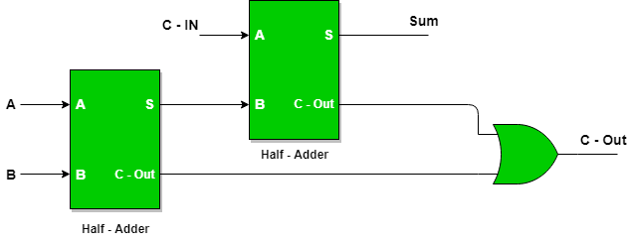
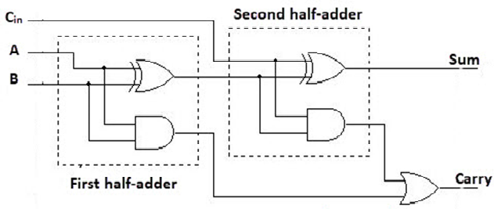
Block Diagram:
Combinational Circuit Diagram:

Slide 13
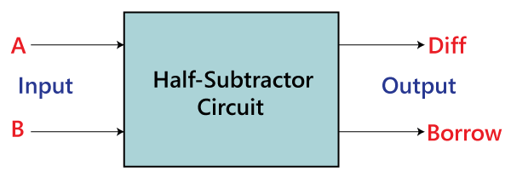
Subtractors
An electronic Combinational logic circuit for calculating the difference between two binary numbers, the minuend and the number to be subtracted, the subtrahend.
There are two types of subtractors ,Full and Half.
HALF SUBTRACTORS
The half subtractor is also a building block for subtracting two binary numbers.
It has two inputs and two outputs.
This circuit is used to subtract two single bit binary numbers A and B.
The 'diff' and 'borrow' are two output states of the half subtractor.
Block diagram

Slide 14
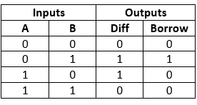
HALF SUBTRACTOR
Truth Table
In above truth table
A' and 'B' are the input variables whose values are going to be subtracted.
The 'Diff' and 'Borrow' are the variables whose values define the subtraction result, i.e., difference and borrow.
The first two rows and the last row, the difference is 1, but the 'Borrow' variable is 0.
The third row is different from the remaining one. When we subtract the bit 1 from the bit 0, the borrow bit is produced.

Slide 15
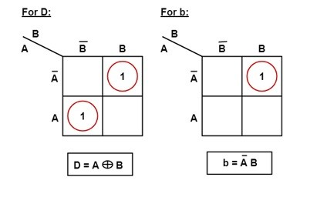
HALF SUBTRACTOR
Logical Expression
Difference = A XOR B Borrow = A’B

Slide 16
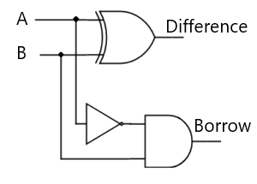
Logic/Combinational Circuit of HALF SUBTRACTOR

Slide 17
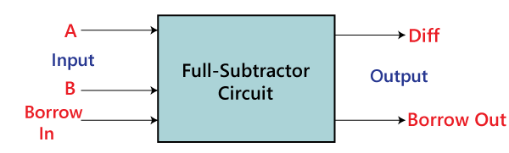
FULL SUBTRACTOR
A full subtractor is a combinational circuit that performs subtraction of two bits, one is minuend and other is subtrahend, taking into account borrow of the previous adjacent lower minuend bit.
This circuit has three inputs and two outputs.
The three inputs A, B and Bin, denote the minuend, subtrahend, and previous borrow, respectively.
The two outputs, D and Bout represent the difference and output borrow, respectively.
Block diagram

Slide 18
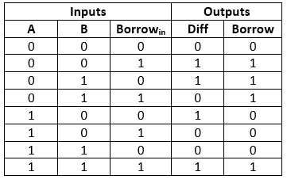
FULL SUBTRACTORS
Truth Table –
In the above table,
'A' and' B' are the input variables. These variables represent the two significant bits that are going to be subtracted.
'Borrow_{in}' is the third input which represents borrow.
The 'Diff' and 'Borrow' are the output variables that define the output values.
The eight rows under the input variable designate all possible combinations of 0 and 1 that can occur in these variables.

Slide 19
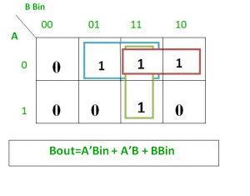
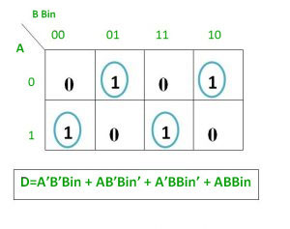
K-map for Borrow (Bout)
K-map for Diff (D)

Slide 20
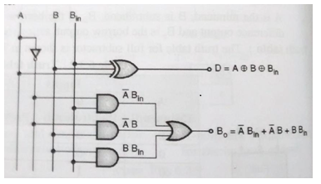
Logic/Combinational Circuit for Full Subtractor –

Slide 21
IMPLEMENTATION OF FULL SUBTRACTOR USING TWO HALF SUBTTRACTOR AND ONE OR GATE
Truth Table
Logical expression for difference –
D = A’B’Bin + A’BBin’ + AB’Bin’ + ABBin
= Bin(A’B’ + AB) + Bin’(AB’ + A’B)
= Bin( A XNOR B) + Bin’(A XOR B)
= Bin (A XOR B)’ + Bin’(A XOR B)
= Bin XOR (A XOR B)
= (A XOR B) XOR Bin

Slide 22
IMPLEMENTATION OF FULL SUBTRACTOR USING TWO HALF SUBTTRACTOR AND ONE OR GATE
Logical expression for borrow –
Bout = A’B’Bin + A’BBin’ + A’BBin + ABBin
= A’B’Bin +A’BBin’ + A’BBin + A’BBin + A’BBin + ABBin
= A’Bin(B + B’) + A’B(Bin + Bin’) + BBin(A + A’)
= A’Bin + A’B + BBin
OR
Bout = A’B’Bin + A’BBin’ + A’BBin + ABBin
= Bin(AB + A’B’) + A’B(Bin + Bin’)
= Bin( A XNOR B) + A’B
= Bin (A XOR B)’ + A’B

Slide 23
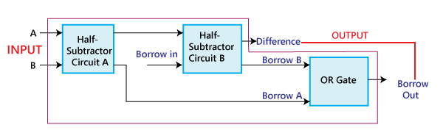
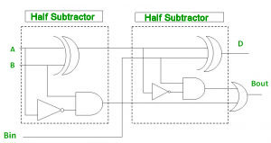
IMPLEMENTATION OF FULL SUBTRACTOR USING TWO HALF SUBTTRACTOR AND ONE OR GATE

Slide 24
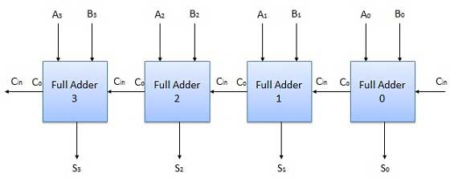
N-Bit Parallel Adder
The Full Adder is capable of adding only two single digit binary number along with a carry input.
But in practical we need to add binary numbers which are much longer than just one bit.
To add two n-bit binary numbers we need to use the n-bit parallel adder. It uses a number of full adders in cascade.
The carry output of the previous full adder is connected to carry input of the next full adder.
4 Bit Parallel Adder
In the block diagram, A0 and B0 represent the LSB of the four bit words A and B.
Hence Full Adder-0 is the lowest stage. Hence its Cin has been permanently made 0.
The rest of the connections are exactly same as those of n-bit parallel adder is shown in fig.
The four bit parallel adder is a very common logic circuit.
Block diagram

Slide 25
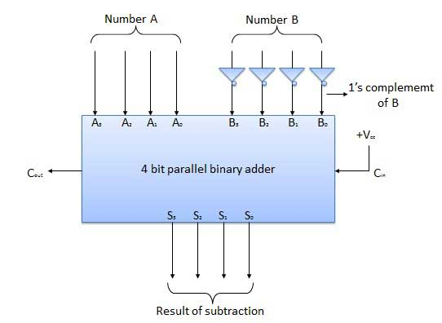
N-Bit Parallel Subtractor
The subtraction can be carried out by taking the 1's or 2's complement of the number to be subtracted.
For example we can perform the subtraction (A-B) by adding either 1's or 2's complement of B to A.
That means we can use a binary adder to perform the binary subtraction.
4 Bit Parallel Subtractor
The number to be subtracted (B) is first passed through inverters to obtain its 1's complement.
The 4-bit adder then adds A and 2's complement of B to produce the subtraction. S3 S2 S1 S0
represents the result of binary subtraction (A-B) and carry output Cout represents the polarity of the result.
If A > B then Cout = 0 and the result of binary form (A-B) then Cout = 1 and the result is in the 2's complement form.
Block diagram

Slide 26
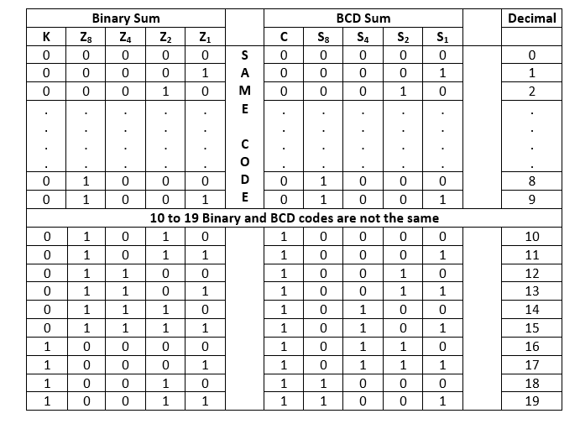
Decimal or BCD Adder
The BCD-Adder is used in the computers and the calculators that perform arithmetic operation directly in the decimal number system.
The BCD-Adder accepts the binary-coded form of decimal numbers. The Decimal-Adder requires a minimum of nine inputs and five outputs.
There is the following table used in designing of BCD-Adder.

Slide 27
From the above table, it is clear that if the produced sum is between 1 to 9, the Binary and the BCD code is the same.
But for 10 to 19 decimal numbers, both the codes are different.
In the above table, the binary sum combinations from 10 to 19 give invalid BCD.
There are the following points that help the circuit to identify the invalid BCD.
It is obvious from the table that a correction is needed when the 'Binary Sum' has an output carry C=1.
The other six combinations from 10 to 15 need correction in which the bit on the Z₈ position is 1.
In the Binary sum of 8 and 9, the bit on the Z₈ position is also 1. So, the second step fails, and we need to modify it.
To distinguish these two numbers, we specify that the bit on the Z₄ or Z₂ position also needs to be 1 with the bit of Z₈
The condition for a correction and an output carry can be expressed by the Boolean function:
C=C+s3+s2+s1+s0
Once the circuit found the invalid BCD, the circuit adds the binary number of 6 into the invalid BCD code to make it valid.

Slide 28
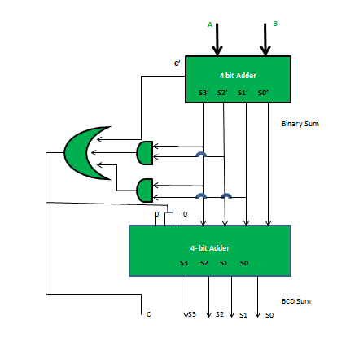

Slide 29
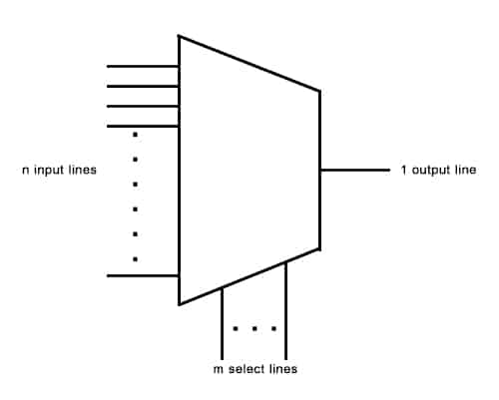
Multiplexer
A multiplexer is a combinational circuit that has 2^{n} input lines and a single output line.
Simply, the multiplexer is a multi-input and single-output combinational circuit.
The binary information is received from the input lines and directed to the output line.
A multiplexer of 2^{n} inputs has n select lines that will be used to select input line to send to the output.
Multiplexer is abbreviated as Mux.
There are various types of the multiplexer which are as follows:
They are
2 :1
4:1
8:1
16:1

Slide 30
Advantages and Disadvantages of Multiplexer
The advantages of multiplexer include the following.
In multiplexer, the usage of a number of wires can be decreased
It reduces the cost as well as the complexity of the circuit
The implementation of a number of combination circuits can be possible by using a multiplexer
Mux doesn’t require K-maps & simplification
The multiplexer can make the transmission circuit less complex & economical
The multiplexer ability can be extended to switch audio signals, video signals, etc.
The digital system reliability can be improved using a MUX as it decreases the number of exterior wired connections.
MUX is used to implement several combinational circuits
The disadvantages of multiplexer include the following.
Additional delays required within switching ports & I/O signals which propagate throughout the multiplexer.
The ports which can be utilized at the same time have limitations
Switching ports can be handled by adding the complexity of firmware
The controlling of multiplexer can be done by using additional I/O ports.
Applications of Multiplexers
Communication System
Computer Memory
Transmission from the Computer System of a Satellite

Slide 31
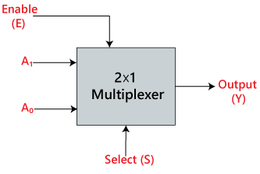
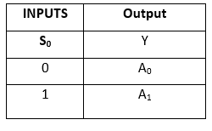
2 X 1 /(2:1) MUX
2×1 Multiplexer:
In 2×1 multiplexer, there are only two inputs, i.e., A₀ and A₁, 1 selection line, i.e., S₀ and single outputs, i.e., Y.
On the basis of the combination of inputs which are present at the selection line S⁰, one of these 2 inputs will be connected to the output.
The block diagram and the truth table of the 2×1 multiplexer are given below.
Truth Table:
The logical expression of the term Y is as follows:
Y=S0'.A0+S0.A1
Block Diagram

Slide 32
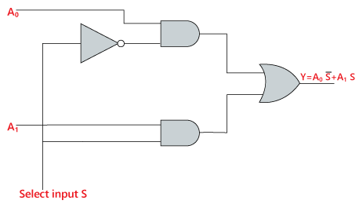
Logical circuit of the above expression is given below:

Slide 33
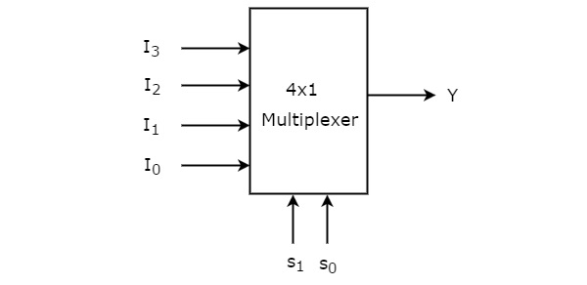
4:1/(4X1) MUX
4x1 Multiplexer has four data inputs I3, I2, I1 & I0, two selection lines s1 & s0 and one output Y.
The block diagram of 4x1 Multiplexer is shown in the following figure.
One of these 4 inputs will be connected to the output based on the combination of inputs present at these
two selection lines.
Truth table of 4x1 Multiplexer is shown below.
Selection Lines |  | Output
S₁ | S₀ | Y
0 | 0 | I₀
0 | 1 | I₁
1 | 0 | I₂
1 | 1 | I₃
Block Diagram
From Truth table, we can directly write the Boolean function for output, Y as
Y=S1′S0′I0+S1′S0I1+S1S0′I2+S1S0I3

Slide 34
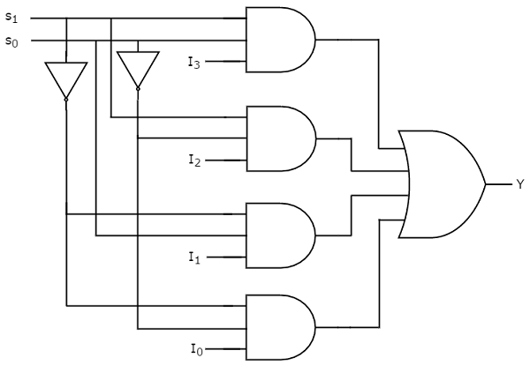
The circuit diagram of 4x1 multiplexer is shown in the following figure.

Slide 35
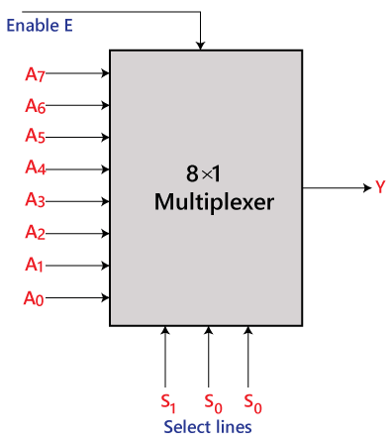
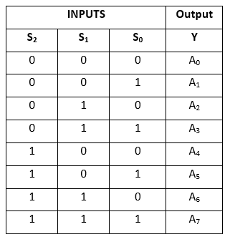
8X1 / (8:1) MUX
In the 8 to 1 multiplexer, there are total eight inputs, i.e., A₀, A₁, A₂, A₃, A₄, A₅, A₆, and A₇, 3 selection lines, i.e., S₀, S₁and S₂ and single output, i.e., Y.
On the basis of the combination of inputs that are present at the selection lines S⁰, S^{1,} and S₂, one of these 8 inputs are connected to the output.
Truth table of 8x1 Multiplexer is shown below.
The logical expression of the term Y is as follows:
Y=S0'.S1'.S2'.A0+S0.S1'.S2'.A1+S0'.S1.S2'.A2+S0.S1.S2'.A3+S0'.S1'.S2 A4+S0.S1'.S2 A5+S0'.S1.S2 .A6+
S0.S1.S3.A7
Block Diagram

Slide 36
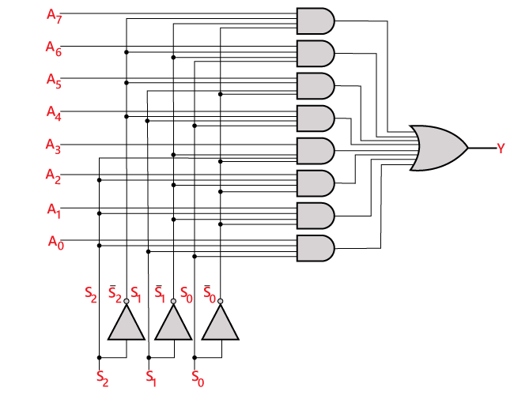
Logical circuit of the above expression is given below:

Slide 37
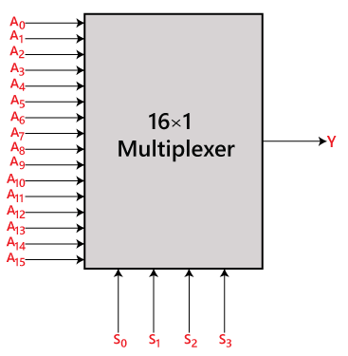
16X1 / (16:1) MUX
In the 16 to 1 multiplexer, there are total of 16 inputs, i.e., A0, A1, …, A16, 4 selection lines, i.e., S0, S1, S2, and S3 and
single output ,i.e., Y. On the basis of the combination of inputs that are present at the selection lines S0, S1,S2 and S3,
one of these 16 inputs will be connected to the output.
Block Diagram

Slide 38
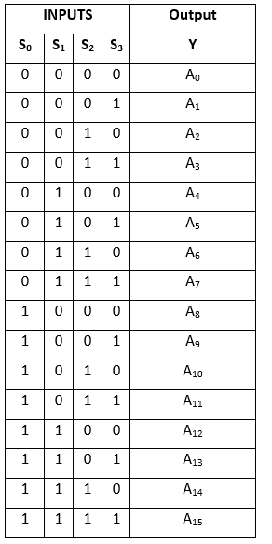
Truth Table:
The logical expression of the term Y is as follows:
Y=A₀.S₀'.S₁'.S₂'.S₃'+A₁.S₀'.S₁'.S₂ '.S₃+A₂.S₀'.S₁'.S₂.S₃'+A₃.S₀'.S₁ '.S₂.S₃+A₄.S₀'.S₁.S₂'.S₃'+A₅.S₀ '.S₁.S₂'.S₃+A₆.S₁.S₂.S₃'+A₇.S₀ '.S₁.S₂.S₃+A₈.S₀.S₁'.S₂'.S₃'+A₉ .S₀.S₁'.S₂'.S₃+Y₁0.S₀.S₁'.S₂.S₃ '+A₁1.S₀.S₁'.S₂.S₃+A₁2 S₀.S₁.S₂ '.S₃'+A₁3.S₀.S₁.S₂'.S₃+A₁4.S₀.S₁ .S₂.S₃'+A₁5.S₀.S₁.S₂'.S₃

Slide 39
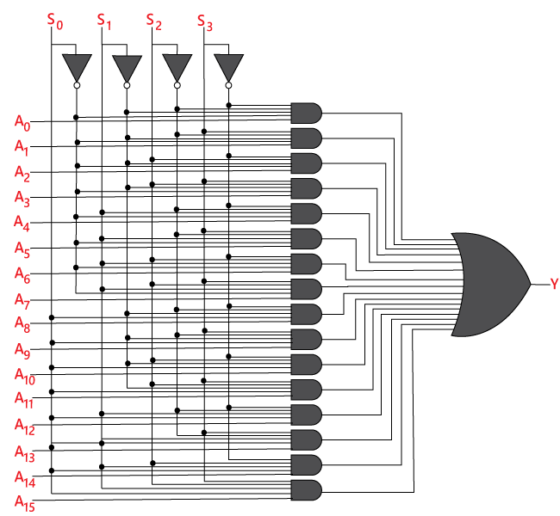
Logical circuit of the above expression is given below:

Slide 40
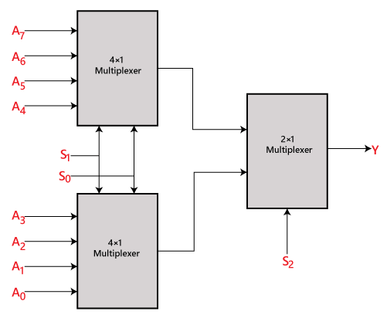
8 ×1 multiplexer using 4×1 and 2×1 multiplexer
We can implement the 8×1 multiplexer using a lower order multiplexer.
To implement the 8×1 multiplexer, we need two 4×1 multiplexers and one 2×1 multiplexer.
The 4×1 multiplexer has 2 selection lines, 4 inputs, and 1 output. The 2×1 multiplexer has only 1 selection line.
For getting 8 data inputs, we need two 4×1 multiplexers.
The 4×1 multiplexer produces one output.
So, in order to get the final output, we need a 2×1 multiplexer.
The block diagram of 8×1 multiplexer using 4×1 and 2×1 multiplexer is given below.

Slide 41
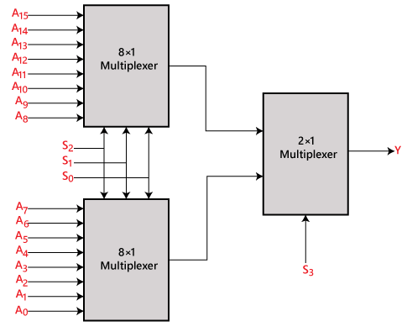
16×1 multiplexer using 8×1 and 2×1 multiplexer
We can implement the 16×1 multiplexer using a lower order multiplexer.
To implement the 8×1 multiplexer, we need two 8×1 multiplexers and one 2×1 multiplexer.
The 8×1 multiplexer has 3 selection lines, 4 inputs, and 1 output.
The 2×1 multiplexer has only 1 selection line.
For getting 16 data inputs, we need two 8 ×1 multiplexers.
The 8×1 multiplexer produces one output.
So, in order to get the final output, we need a 2×1 multiplexer.
The block diagram of 16×1 multiplexer using 8×1 and 2×1 multiplexer is given below.

Slide 42
Demultiplexer
A De-multiplexer is a combinational circuit that has only 1 input line and 2^{N} output lines.
Simply, the De-multiplexer is a single-input and multi-output combinational circuit.
The information is received from the single input lines and directed to the output line.
On the basis of the values of the selection lines, the input will be connected to one of these outputs.
De-multiplexer is opposite to the multiplexer.
Select Lines is based on N output lines.
De-multiplexer is also treated as De-mux.
Applications of Demultiplexers
The applications include:
Demultiplexers are used in clock data recovery solutions.
Demultiplexer along with multiplexer is necessary for any communication system for data transmission.
Demultiplexers are used in ATM packets broadcasting.
The output of Arithmetic Logic Unit is stored in respective registers using Demultiplexers.
They act as Serial to Parallel converter.
They are also used in Wavelength routers.

Slide 43
Advantages of Demultiplexers
The advantages include:
Transmission of Audio/Video signals requires combination of Multiplexers and Demultiplexers.
They are also used as decoders in security systems like banking sectors.
Combination of De-muxes with Muxes increases the efficiency of the communication system.
Disadvantages of Demultiplexers
The disadvantages include:
Wastage of Bandwidth might occur.
Delays might occur due to synchronization of signals.
Types of Demultiplexer:
1:2 De-mux
1:4 De-mux
1:8 De-mux
1:16 De-mux

Slide 44
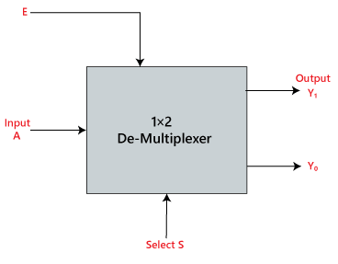
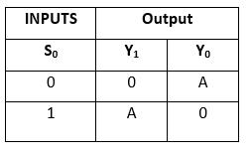
1×2 De-multiplexer:
In the 1 to 2 De-multiplexer, there are only two outputs, i.e., Y₀, and Y₁, 1 selection lines, i.e., S₀, and single input, i.e., A.
On the basis of the selection value, the input will be connected to one of the outputs.
The block diagram and the truth table of the 1×2 multiplexer are given below.
Truth Table:
The logical expression of the term Y is as follows:
Y0=S0’.A Y1=S0.A
Block Diagram

Slide 45
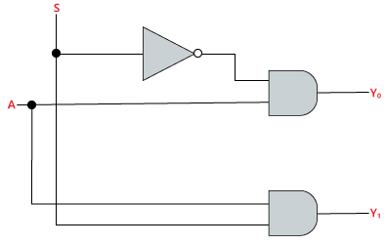
Logical circuit of the above expressions is given below:

Slide 46
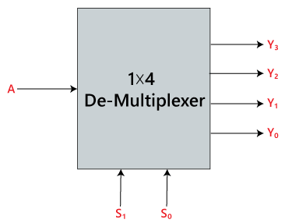
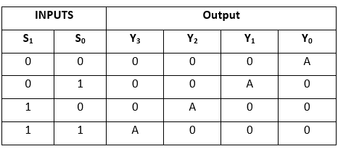
1×4 De-multiplexer:
In 1 to 4 De-multiplexer, there are total of four outputs, i.e., Y0, Y1, Y2, and Y3, 2 selection lines, i.e., S0 and S1 and single input, i.e., A.
On the basis of the combination of inputs which are present at the selection lines S0 and S1, the input be connected to one of the outputs.
The block diagram and the truth table of the 1×4 multiplexer are given below.
Truth Table:
The logical expression of the term Y is as follows:
Y0=S1' S0' A y1=S1' S0 A y2=S1 S0' A y3=S1 S0 A
Block Diagram

Slide 47
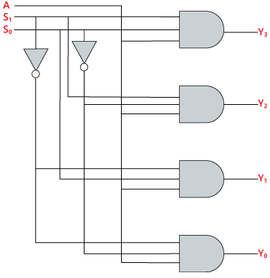
Logical circuit of the above expressions is given below:

Slide 48
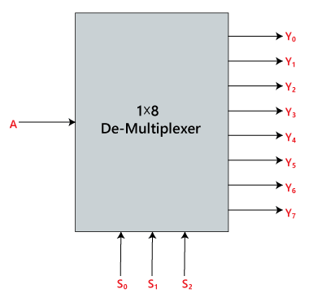
1×8 De-multiplexer:
In 1 to 8 De-multiplexer, there are total of eight outputs, i.e., Y0, Y1, Y2, Y3, Y4, Y5, Y6, and Y7, 3 selection lines, i.e., S0, S1and S2 and single input, i.e., A.
On the basis of the combination of inputs which are present at the selection lines S0, S1 and S2, the input will be connected to one of these outputs.
The block diagram and the truth table of the 1×8 de-multiplexer are given below.
Block Diagram

Slide 49
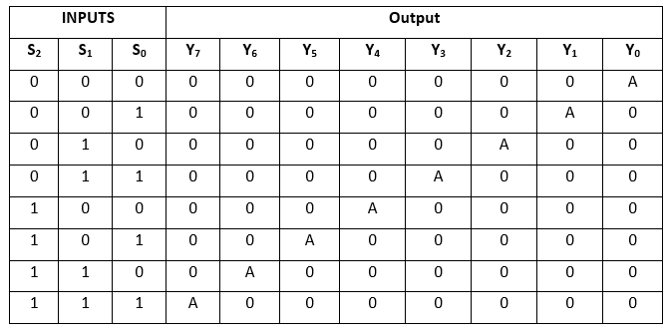
Truth Table:
The logical expression of the term Y is as follows:
Y0=S0'.S1'.S2'.A Y1=S0.S1'.S2'.A Y2=S0'.S1.S2'.A Y3=S0.S1.S2'.A Y4=S0'.S1'.S2 A Y5=S0.S1'.S2 A Y6=S0'.S1.S2 A Y7=S0.S1.S3.A

Slide 50

Logical circuit of the above expressions is given below:

Slide 51

1 x 16 De-multiplexer
In 1×16 de-multiplexer, there are total of 16 outputs, i.e., Y₀, Y₁, …, Y₁₆, 4 selection lines, i.e., S₀, S₁, S₂, and S₃ and single input, i.e., A.
On the basis of the combination of inputs which are present at the selection lines S⁰, S¹, and S₂, the input will be connected to one of these outputs.
The block diagram and the truth table of the 1×16 de-multiplexer are given below.
Block Diagram

Slide 52

Truth Table:

Slide 53
The logical expression of the term Y is as follows:
Y₀=A.S₀'.S₁'.S₂'.S₃' Y₁=A.S₀'.S₁'.S₂'.S₃ Y₂=A.S₀'.S₁'.S₂.S₃' Y₃=A.S₀'.S₁'.S₂.S₃ Y₄=A.S₀'.S₁.S₂'.S₃' Y₅=A.S₀'.S₁.S₂'.S₃ Y₆=A.S₀'.S₁.S₂.S₃' Y₇=A.S₀'.S₁.S₂.S₃ Y₈=A.S₀.S₁'.S₂'.S₃' Y₉=A.S₀.S₁'.S₂'.S₃ Y₁₀=A.S₀.S₁'.S₂.S₃' Y₁₁=A.S₀.S₁'.S₂.S₃ Y₁₂=A.S₀.S₁.S₂'.S₃' Y₁₃=A.S₀.S₁.S₂'.S₃ Y₁₄=A.S₀.S₁.S₂.S₃’ Y₁₅=A.S₀.S₁.S₂'.S₃

Slide 54

Logical circuit of the above expressions is given below:

Slide 55
CODE conversion( BCD to excess-3, 8 4 -2 -1 code to bcd, 2421 code to 8 4 -2 1 code)
BCD(8 4 2 1) to excess-3
The Excess-3 binary code is an example of a self-complementary BCD code.
A self-complementary binary code is a code which is always complimented in itself.
By replacing the bit 0 to 1 and 1 to 0 of a number, we find the 1's complement of the number.
The sum of the 1'st complement and the binary number of a decimal is equal to the binary number of decimal 9.
The process of converting BCD to Excess-3 is quite simple from other conversions.
The Excess-3 code can be calculated by adding 3, i.e., 0011 to each four-digit BCD code. Below is the truth table for the conversion of BCD to Excess-3 code.
In the below table, the variables A, B, C, and D represent the bits of the binary numbers.
The variable 'D' represents the LSB, and the variable 'A' represents the MSB.
In the same way, the variables w, x, y, and z represent the bits of the Excess-3 code.
The variable 'z' represents the LSB, and the variable 'w' represents the MSB.
The 'don't care conditions' is expressed by the variable 'X'.

Slide 56
TRUTH TABLE:
Decimal Number | BCD Code |  |  |  | Excess-3 Code
 | A | B | C | D | W | x | y | z
0 | 0 | 0 | 0 | 0 | 0 | 0 | 1 | 1
1 | 0 | 0 | 0 | 1 | 0 | 1 | 0 | 0
2 | 0 | 0 | 1 | 0 | 0 | 1 | 0 | 1
3 | 0 | 0 | 1 | 1 | 0 | 1 | 1 | 0
4 | 0 | 1 | 0 | 0 | 0 | 1 | 1 | 1
5 | 0 | 1 | 0 | 1 | 1 | 0 | 0 | 0
6 | 0 | 1 | 1 | 0 | 1 | 0 | 0 | 1
7 | 0 | 1 | 1 | 1 | 1 | 0 | 1 | 0
8 | 1 | 0 | 0 | 0 | 1 | 0 | 1 | 1
9 | 1 | 0 | 0 | 1 | 1 | 1 | 0 | 0
10 | 1 | 0 | 1 | 0 | X | X | X | X
11 | 1 | 0 | 1 | 1 | X | X | X | X
12 | 1 | 1 | 0 | 0 | X | X | X | X
13 | 1 | 1 | 0 | 1 | X | X | X | X
14 | 1 | 1 | 1 | 0 | X | X | X | X
15 | 1 | 1 | 1 | 1 | X | X | X | X
Now, we will use the K-map method to design the logical circuit for the conversion of BCD to Excess-3 code as:

Slide 57

K-Map

Slide 58

Logical Expression
w=A+BC+BD x=B' C+B' D+BC' D' y=CD+C'D' z=D'

Slide 59
Excess-3 to BCD( 8 4 2 1) conversion
The process of converting Excess-3 to BCD is opposite to the process of converting BCD to Excess-3.
The BCD code can be calculated by subtracting 3, i.e., 0011 from each four-digit Excess-3 code.
Below is the truth table for the conversion of Excess-3 code to BCD.
The 'don't care conditions' is defined by the variable 'X'.
Decimal Number | Excess-3 Code |  |  |  | BCD Code
 | A | B | C | D | W | X | Y | Z
0 | 0 | 0 | 0 | 0 | X | X | X | X
1 | 0 | 0 | 0 | 1 | X | X | X | X
2 | 0 | 0 | 1 | 0 | X | X | X | X
3 | 0 | 0 | 1 | 1 | 0 | 0 | 0 | 0
4 | 0 | 1 | 0 | 0 | 0 | 0 | 0 | 1
5 | 0 | 1 | 0 | 1 | 0 | 0 | 1 | 0
6 | 0 | 1 | 1 | 0 | 0 | 0 | 1 | 1
7 | 0 | 1 | 1 | 1 | 0 | 1 | 0 | 0
8 | 1 | 0 | 0 | 0 | 0 | 1 | 0 | 1
9 | 1 | 0 | 0 | 1 | 0 | 1 | 1 | 0
10 | 1 | 0 | 1 | 0 | 0 | 1 | 1 | 1
11 | 1 | 0 | 1 | 1 | 1 | 0 | 0 | 0
12 | 1 | 1 | 0 | 0 | 1 | 0 | 0 | 1
13 | 1 | 1 | 0 | 1 | X | X | X | X
14 | 1 | 1 | 1 | 0 | X | X | X | X
15 | 1 | 1 | 1 | 1 | X | X | X | X
Now, we will use the K-map method to design the logical circuit for the conversion of Excess-3 code to

Slide 60

After K-maps BCD as:
W=AB+ACD X=A’ B’+A’ D’+ACD Y=C’ D+CD’ Z=D'

Slide 61
Binary to Gray Conversion:
It is a logical circuit that is used to convert the binary code into its equivalent Gray code.
Decimal Number | 4-bit Binary Code | 4-bit Gray Code
 | ABCD | G₁G₂G₃G₄
0 | 0000 | 0000
1 | 0001 | 0001
2 | 0010 | 0011
3 | 0011 | 0010
4 | 0100 | 0110
5 | 0101 | 0111
6 | 0110 | 0101
7 | 0111 | 0100
8 | 1000 | 1100
9 | 1001 | 1101
10 | 1010 | 1111
11 | 1011 | 1110
12 | 1100 | 1010
13 | 1101 | 1011
14 | 1110 | 1001
15 | 1111 | 1000

Slide 62





g3=b3=1
g2 = b3 XOR b2
g1= b2 XOR b1
g0= b1 XOR b0

Slide 63

Gray To Binary Conversion:

Slide 64


Slide 65
8 4 -2 -1 code to BCD Converter
Decimal Digit | 84-2-1 Code
 | A B C D
0 | 0 0 0 0
1 | 0 1 1 1
2 | 0 1 1 0
3 | 0 1 0 1
4 | 0 1 0 0
5 | 1 0 1 1
6 | 1 0 1 0
7 | 1 0 0 1
8 | 1 0 0 0
9 | 1 1 1 1
8421 Code
P Q R S
0 0 0 0
0 0 0 1
0 0 1 0
0 0 1 1
0 1 0 0
0 1 0 1
0 1 1 0
0 1 1 1
1 0 0 0
1 0 0 1

Slide 66
BCD(8 4 2 1) to 8 4 -2 -1 code Converter
Decimal Digit
0
1
2
3
4
5
6
7
8
9
8421(BCD) Code
P Q R S
0 0 0 0
0 0 0 1
0 0 1 0
0 0 1 1
0 1 0 0
0 1 0 1
0 1 1 0
0 1 1 1
1 0 0 0
1 0 0 1
84-2-1 Code
A B C D
0 0 0 0
0 1 1 1
0 1 1 0
0 1 0 1
0 1 0 0
1 0 1 1
1 0 1 0
1 0 0 1
1 0 0 0
1 1 1 1

Slide 67
2 4 2 1 to 8 4 2 1(BCD) code Converter
Decimal Digit
0
1
2
3
4
5
6
7
8
9
2421 Code
A B C D
0 0 0 0
0 0 0 1
0 0 1 0
0 0 1 1
0 1 0 0
1 0 1 1
1 1 0 0
1 1 0 1
1 1 1 0
1 1 1 1
8421(BCD) Code
P Q R S
0 0 0 0
0 0 0 1
0 0 1 0
0 0 1 1
0 1 0 0
0 1 0 1
0 1 1 0
0 1 1 1
1 0 0 0
1 0 0 1

Slide 68
8 4 2 1(BCD) to 2 4 2 1 code Converter
Decimal Digit
0
1
2
3
4
5
6
7
8
9
8421(BCD) Code
P Q R S
0 0 0 0
0 0 0 1
0 0 1 0
0 0 1 1
0 1 0 0
0 1 0 1
0 1 1 0
0 1 1 1
1 0 0 0
1 0 0 1
2421 Code
A B C D
0 0 0 0
0 0 0 1
0 0 1 0
0 0 1 1
0 1 0 0
1 0 1 1
1 1 0 0
1 1 0 1
1 1 1 0
1 1 1 1

Slide 69

Encoder
An encoder is a combinational circuit that converts binary information in the form of a 2^{N} input lines into N output lines, which represent N bit code for the input.
The combinational circuits that change the binary information into N output lines are known as Encoders.
The binary information is passed in the form of 2^{N} input lines. The output lines define the N-bit code for the binary information.
At a time, only one input line is activated for simplicity. The produced N-bit output code is equivalent to the binary information.
Applications of the Encoder
Speed synchronization of multiple motors in industries
War field flying robot with a night vision flying camera
Robotic vehicle with the metal detector
RF based home automation system
Automatic health monitoring systems
Encoders are used to convert a decimal number into the binary number.

Slide 70


Types of Encoder
4 to 2 line Encoder:
In 4 to 2 line encoder, there are total of four inputs, i.e., Y0, Y1, Y2, and Y3, and two outputs, i.e., A0 and A1.
In 4-input lines, one input-line is set to true at a time to get the respective binary code in the output side.
Below are the block diagram and the truth table of the 4 to 2 line encoder.
Block Diagram:
Truth Table:

Slide 71

The logical expression of the term A0 and A1 is as follows:
A1=Y3+Y2 A0=Y3+Y1
Logical circuit/Combinational Circuit of the above expressions is given below:

Slide 72


8 to 3 line Encoder/Octal to Binary
The 8 to 3 line Encoder is also known as Octal to Binary Encoder.
In 8 to 3 line encoder, there is a total of eight inputs, i.e., Y0, Y1, Y2, Y3, Y4, Y5, Y6, and Y7 and three outputs,
i.e., A0, A1, and A2.
In 8-input lines, one input-line is set to true at a time to get the respective binary code in the output side.
Below are the block diagram and the truth table of the 8 to 3 line encoder.
Block Diagram: Truth Table:

Slide 73

The logical expression of the term A0, A1, and A2 are as follows:
A2=Y4+Y5+Y6+Y7 A1=Y2+Y3+Y6+Y7 A0=Y7+Y5+Y3+Y1
Logical circuit of the above expressions is given below:

Slide 74

Decimal to BCD Line Encoder
The Octal to Binary Encoder is also known as 10 to 4 line Encoder.
In 10 to 4 line encoder, there are total of ten inputs, i.e., Y0, Y1, Y2, Y3, Y4, Y5, Y6, Y7, Y8, and Y9 and four outputs., A0, A1, A2, and A3. In 10-input lines, one input-line is set to true at a time to get the respective BCD code in the
output side.
The block diagram and the truth table of the decimal to BCD encoder are given below.
Block Diagram:

Slide 75

Truth Table:
The logical expression of the term A0, A1, A2, and A3 is as follows:
A3=Y9+Y8 A2=Y7+Y6+Y5+Y4 A1=Y7+Y6+Y3+Y2 A0 = Y9 + Y7 +Y5 +Y3 + Y1

Slide 76

Logical circuit of the above expressions is given below:

Slide 77
Priority Encoder
A 4 to 2 priority encoder has four inputs Y3, Y2, Y1 & Y0 and two outputs A1 & A0.
Here, the input, Y3 has the highest priority, whereas the input, Y0 has the lowest priority.
In this case, even if more than one input is ‘1’ at the same time, the output will be the binary code
corresponding to the input, which is having higher priority.
We considered one more output, V in order to know, whether the code available at outputs is valid or not.
If at least one input of the encoder is ‘1’, then the code available at outputs is a valid one. In this case, the output,
V will be equal to 1.
If all the inputs of encoder are ‘0’, then the code available at outputs is not a valid one. In this case, the output,
V will be equal to 0.

Slide 78
The Truth table of 4 to 2 priority encoder is shown below.
.
Inputs |  |  |  | Outputs
Y₃ | Y₂ | Y₁ | Y₀ | A₁ | A₀ | V
0 | 0 | 0 | 0 | 0 | 0 | 0
0 | 0 | 0 | 1 | 0 | 0 | 1
0 | 0 | 1 | x | 0 | 1 | 1
0 | 1 | x | x | 1 | 0 | 1
1 | x | x | x | 1 | 1 | 1
Use 4 variable K-maps for getting simplified expressions for each output

Slide 79

Use 4 variable K-maps for getting simplified expressions for each output.
The simplified Boolean functions are
A1=Y3+Y2A1=Y3+Y2
A0=Y3+Y2′Y1A0=Y3+Y2′Y1
Similarly, we will get the Boolean function of output, V as
V=Y3+Y2+Y1+Y0

Slide 80

We can implement the above Boolean functions using logic gates.
The circuit diagram of 4 to 2 priority encoder is shown in the following figure.

Slide 81

Decoder
Decoder is a combinational circuit that has ‘n’ input lines and maximum of 2n output lines.
One of these outputs will be active High based on the combination of inputs present, when the decoder is enabled.
That means decoder detects a particular code.
The outputs of the decoder are nothing but the min terms of ‘n’ input variables lines, when it is enabled.
The produced 2N-bit output code is equivalent to the binary information.
There are various types of decoders which are as follows:

Slide 82

2 to 4 Decoder
Let 2 to 4 Decoder has two inputs A1 & A0 and four outputs Y3, Y2, Y1 & Y0.
The block diagram of 2 to 4 decoder is shown in the following figure.
One of these four outputs will be ‘1’ for each combination of inputs when enable, E is ‘1’.

Slide 83
The Truth table of 2 to 4 decoder is shown below.
Enable | Inputs |  | Outputs
E | A₁ | A₀ | Y₃ | Y₂ | Y₁ | Y₀
0 | x | x | 0 | 0 | 0 | 0
1 | 0 | 0 | 0 | 0 | 0 | 1
1 | 0 | 1 | 0 | 0 | 1 | 0
1 | 1 | 0 | 0 | 1 | 0 | 0
1 | 1 | 1 | 1 | 0 | 0 | 0
From Truth table, we can write the Boolean functions for each output as
Y3=E.A1.A0
Y2=E.A1.A0′
Y1=E.A1′.A0
Y0=E.A1′.A0′

Slide 84

Each output is having one product term.
So, there are four product terms in total.
We can implement these four product terms by using four AND gates having three inputs each & two inverters.
The circuit diagram of 2 to 4 decoder is shown in the following figure.

Slide 85

3 to 8 line decoder:
The 3 to 8 line decoder is also known as Binary to Octal Decoder.
In a 3 to 8 line decoder, there is a total of eight outputs, i.e., Y0, Y1, Y2, Y3, Y4, Y5, Y6, and Y7 and
three outputs, i.e., A0, A1, and A2.
This circuit has an enable input 'E'. Just like 2 to 4 line decoder, when enable 'E' is set to 1, one of these
four outputs will be 1.
The block diagram and the truth table of the 3 to 8 line encoder are given below.
Block Diagram:

Slide 86

Truth Table:
The logical expression of the term Y0, Y1, Y2, Y3, Y4, Y5, Y6, and Y7 is as follows:
Y0=A0'.A1'.A2' Y1=A0.A1'.A2' Y2=A0'.A1.A2' Y3=A0.A1.A2'
Y4=A0'.A1'.A2 Y5=A0.A1'.A2 Y6=A0'.A1.A2 Y7=A0.A1.A2

Slide 87

Logical circuit of the above expressions is given below:

Slide 88

4 to 16 line Decoder:
In the 4 to 16 line decoder, there is a total of 16 outputs, i.e., Y₀, Y₁, Y₂,……, Y₁₆ and four inputs, i.e., A₀, A1, A₂, and A₃.

Slide 89

BCD to 7 – Segment Decoder
Light Emitting Diode is most widely used semiconductor which emit either visible light or invisible infrared light
when forward biased.
A Light emitting diodes (LED) is an optical electrical energy into light energy when voltage is applied.
Seven Segment Displays
Seven segment displays are the output display device that provide a way to display information in the form of
image or text or decimal numbers which is an alternative to the more complex dot matrix displays.
It is widely used in digital clocks, basic calculators, electronic meters, and other electronic device that display
numerical information.
It consists seven segments of light emitting diodes (LEDs) which is assembled like numerical 8.
Working of Seven Segment Displays

Slide 90


Slide 91

Truth Table BCD to seven segment decoder

Slide 92


K-Maps: #for a:
K-Maps: #for b:

Slide 93


K-Maps: #for c:
K-Maps: #for d:

Slide 94



K-Maps: #for e:
K-Maps: #for f:
K-Maps: #for g:

Slide 95

From the above simplification, we get the output values as
Applications of Seven Segment Displays
Common applications of seven segment displays are in:
Digital clocks
Clock radios
Calculators
Wristwatchers
Speedometers
Motor-vehicle odometers
Radio frequency indicators

Slide 96


Slide 97
Programmable Logic Devices PLDs
PLDs are the integrated circuits that contain an array of AND gates & another array of OR gates.
There are three kinds of PLDs based on the type of arrays, which has programmable feature.
Programmable Read Only Memory
Programmable Array Logic
Programmable Logic Array
Programmable Read Only Memory PROM/ROM
Read Only Memory ROM is a memory device, which stores the binary information permanently.
That means, we can’t change that stored information by any means later.
If the ROM has programmable feature, then it is called as Programmable ROM PROM.
The user has the flexibility to program the binary information electrically once by using PROM programmer.
PROM is a programmable logic device that has fixed AND array & Programmable OR array.

Slide 98

The block diagram of PROM
Here, the inputs of AND gates are not of programmable type.
So, we have to generate 2^{n} product terms by using 2^{n} AND gates having n inputs each.
We can implement these product terms by using nx2^{n} decoder. So, this decoder generates ‘n’ min terms.
Here, the inputs of OR gates are programmable.
That means, we can program any number of required product terms, since all the outputs of AND gates are applied as inputs to each OR gate.
Therefore, the outputs of PROM will be in the form of sum of min terms.

Slide 99
Example
Let us implement the following Boolean functions using PROM.
A(X,Y,Z)=∑m(5,6,7)A(X,Y,Z)=∑m(5,6,7)
B(X,Y,Z)=∑m(3,5,6,7)
The given two functions are in sum of min terms form and each function is having three variables X, Y & Z.
So, we require a 3 to 8 decoder and two programmable OR gates for producing these two functions.
The corresponding PROM is shown in the following figure.

Slide 100

Here, 3 to 8 decoder generates eight min terms. The two programmable OR gates have the access of all these min terms. But, only the required min terms are programmed in order to produce the respective Boolean functions by each OR gate. The symbol ‘X’ is used for programmable connections.

Slide 101

Programming Logic Array
Programmable Logic Array(PLA) is a fixed architecture logic device with programmable AND gates followed by programmable OR gates.
PLA is basically a type of programmable logic device used to build a reconfigurable digital circuit.
PLDs have an undefined function at the time of manufacturing, but they are programmed before made into use.
PLA is a combination of memory and logic.
Applications:
PLA is used to provide control over Datapath.
PLA is used as a counter.
PLA is used as a decoder.
PLA is used as a BUS interface in programmed I/O.
The block diagram of PLA is shown in the following figure.

Slide 102
Here, the inputs of AND gates are programmable.
That means each AND gate has both normal and complemented inputs of variables.
So, based on the requirement, we can program any of those inputs.
So, we can generate only the required product terms by using these AND gates.
Here, the inputs of OR gates are also programmable.
So, we can program any number of required product terms, since all the outputs of AND gates are applied as inputs to each OR gate.
Therefore, the outputs of PAL will be in the form of sum of products form.
Example
Let us implement the following Boolean functions using PLA.
A=XY+XZ′A=XY+XZ′
B=XY′+YZ+XZ′B=XY′+YZ+XZ′
The given two functions are in sum of products form.
The number of product terms present in the given Boolean functions A & B are two and three respectively.
One product term, Z′XZ′X is common in each function.
So, we require four programmable AND gates & two programmable OR gates for producing those two functions.
The corresponding PLA is shown in the following figure.

Slide 103

Combinational Circuit of PLA

Slide 104
END of UNITS

